Slide 1
ADVANCED PROGRAMMING-ITIC 2223
Lecture 03- Variables and Functions
Ramesh Madhuranga
MPhil.(Reading) (USJP), BICT (Hons) (RUSL), AMCSSL
Department of Biosystems Technology
Faculty of Technology
Kotelawala Defence University

Slide 2
What is a Variable ?
Variables are nothing but reserved memory locations to store values.
Based on the data type of a variable, the python interpreter allocates memory and decides what can be stored in the reserved memory.
count = 500
name = “Peter”

Slide 3
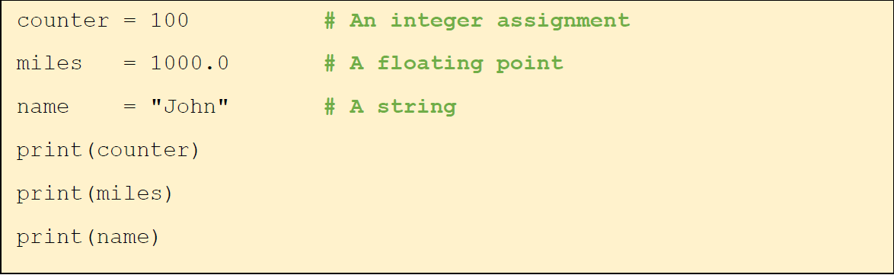
Assigning Values to Variables
This is how we create a variable called marks, which contains an integer value of 78.
marks = 78
Answer for print(marks) is 78
No need to specify the type of a variable when declaring one.

Slide 4
Naming Rules in Python Variables
Python variables can only begin with a letter(A-Z/a-z) or an underscore(_).
A variable name cannot contain spaces.
name = "Amal " , Age = 25 , _marks = 50.8 # valid syntax
7abc =25 , $name = " abc ", mark s = 70 # invalid syntax

Slide 5
Naming Rules in Python Variables
The rest of the identifier may contain letters(A-Z/a-z), underscores(_), and numbers(0-9).
Name1 = " John " # valid syntax Name@ = " Peter " # invalid syntax
python is case-sensitive, and so are Python identifiers.
Here abc and Abc are two
different variables
abc = 50
Abc = 60

Slide 6
Variables –Exercises
Use python IDLE to answer all the questions.
f = 3.56 # a floating point number
a = "Python" # a string
b= "Programming" # a string
Display the output of all variables using print() command
combination = a + " " + b
Display the output of combination using print() command
sum = f + f
Display the output of sum using print() command

Slide 7
What is a function?
Function is a sequence of statements in a certain order, given a name.
When called, those statements are executed.
It provides code re-usability.

Slide 8
Function Types
There are mainly four types of python functions.
User Defined Functions
Built –in Functions
Lamda Functions
Recursion Functions
Let’s talk about Built-in and User Defined Functions.

Slide 9
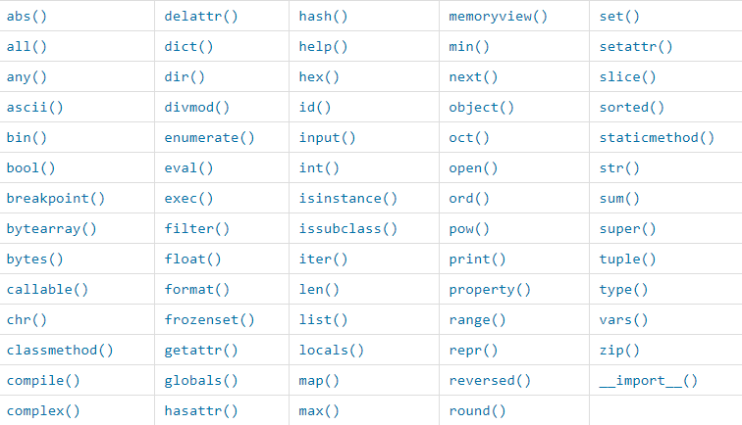
Built- in Functions
The Python interpreter has a number of functions and types built into it that are always available.
Let’s talk about input() and print() functions

Slide 10
Print() Function
The print() function prints the specified message to the screen, or other standard output device.
print("hello !!!") – gives the output of hello !!!
print(1500) print(3.5)
print("python programming") print("Next function, please!")
Output
1500
3.5
python programming Next function, please!

Slide 11
Input() Function
The input() function allows user input and reads one line from standard input and returns it as a string.
a = input("Enter your name: ") print(“Your name is: ", a)
This would prompt you to enter any string and it would display same string on the screen.
Output
Enter your name: Kamal Your name is: Kamal
Can enter any string
value

Slide 12
User Defined Functions
You can define functions to provide the required functionality.
def abc():
"This prints hello and world string values"
print("Hello") print("World") return;
The first statement of a function can be an optional statement
A Python function may optionally return a value
Once you call the function you get the output results.
Hello
abc()
World

Slide 13
Python Function with Parameters
Parameters(Arguments) are specified after the function name, inside the parentheses “( )”.
Function with one argument (abc)
# Function definition is here
def printme(abc):
"This prints a string value"
print(abc) return;
# Now you can call printme function
printme("hello world") printme("second call to the same function")
Output
hello world
second call to the same function

Slide 14
Functions - Exercise
Create two different functions for addition, Subtraction with two parameters for each function and call them to print the calculations.
def addition(num1,num2):
print("answer is: " ,num1+num2)
def subtraction(num1,num2): print("answer is: " ,num1-num2)
addition(50,20) addition(40,50) addition(100,20) subtraction(50,20) subtraction(100,20) subtraction(200,100)
Output
answer is: 70
answer is: 90
answer is: 120
answer is: 30
answer is: 80
answer is: 100

Slide 15
Lesson Summary
Variable – Definition
Assigning Values to Variables
Function – Definition
Input/Output Function
User Defined Functions

Slide 16
Activity 02
Create a user-defined function called square().The function should, Accept one number and Return its square.
Write a function named largest() that accepts two numbers and prints the larger number.

Slide 17
Thank You.

